Slide 1
M.TECH CLOUD COMPUTING · WILP DISSERTATION CCZG628T · FINAL DEFENCE
Semantic Reconstruction
of Software Intent
A Cloud-Hosted Agentic AI Solution for the Study of
Requirement Traceability in Production-Grade Codebases
CANDIDATE
SUPERVISOR · EXAMINER · MENTOR
Aarya Nanndaann Singh M N
Mr. Hanumanthu Indrakanti — Director of Engineering
BITS ID · 2024MT03013 | M.Tech Cloud Computing
Mr. Deepan Kumar — Staff Engineer
Aqueralabs India Pvt Ltd, Bangalore
Mr. Paresh Saxena — BITS Pilani Faculty Mentor
Birla Institute of Technology and Science, Pilani · WILP Division · May 2026

Slide 2
ROADMAP · 6 SECTIONS · ~28 MINUTES
What we will cover today
01
02
03
The Problem
Architecture
Chunking, Embeddings, Retrieval
Intent erosion in production codebases
Why code-only is not enough
Five-layer reference architecture
On AWS + MongoDB Atlas + OpenAI
Section-aware chunks · 1536-d embeddings
Multi-query RAG with max-pool
04
05
06
IDE Integration & Cloud
Evaluation & Metrics
What's Next
VS Code / Cursor extension + loopback git agent
AWS Lambdas, EventBridge, Secrets Manager
Functional checks · retrieval quality
Latency, cost and cognitive-load study
Honest limitations · current improvements
Five directions for future work
IntentEra · Final Defence · Agenda
02 / 33

Slide 3
SECTION 01 · CHAPTERS 1 & 3
The Problem.
Source code answers what. The interesting question is why.
IntentEra · Final Defence · The Problem
03 / 33

Slide 4
PHENOMENON
Intent erosion: rationale gets lost over time
OBSERVABLE COST
DEFINITION
The progressive loss of contextual rationale behind code as time passes — as authors leave the organisation and as artifacts become stale or scattered.
• Long onboarding ramps for new joiners
• Recurring bugs that re-introduce previously fixed regressions
• Cognitive load of "context archaeology" through tickets, commits and chat
• Architectural decisions repeated because the why was never recorded
THE WHY QUESTIONS THAT SOURCE CODE ALONE CANNOT ANSWER
Why was this written this way?
Which requirement triggered this change?
Does the fix actually resolve the original defect?
How does this interact with previous decisions?
IntentEra · Final Defence · The Problem · Ch 1.1
04 / 33

Slide 5
PROBLEM SETTING
The reality at Aqueralabs: knowledge lives in silos
Atlassian Jira
Confluence
GitHub
CI / CD
Requirements
& incident tickets
Design docs
& meeting notes
Commits, PRs
& review threads
Build, validation
& deployment
THE DAILY JOIN PROBLEM
The rationale behind any non-trivial code change is split across three or more of these platforms.
New joiners and contributors perform the same mental joins repeatedly, often with incomplete information. We needed a semantic intermediary that ingests once, reconstructs intent on demand, and surfaces it inside the developer's existing tooling.
IntentEra · Final Defence · The Problem · Ch 1.2
05 / 33

Slide 6
WHAT WE SET OUT TO DO
Formal statement and dissertation objectives
OBJECTIVES
FORMAL STATEMENT
Given
1
Characterise
intent erosion with concrete examples from production
(R, C, D, q) → (E, S)
2
Design
a semantic reconstruction framework — metadata + embeddings
• R — requirement-bearing artifacts (Jira, Confluence)
• C — code-related artifacts (commits, PRs, reviews)
• D — developer's working tree, file f, range ⟨a, b⟩
• q — natural-language question from the developer
• E — explanation in plain language
• S — citation set, every claim attributable to it
3
Architect
a cloud-hosted agentic AI system combining RAG + multi-agent reasoning
4
Integrate
with VS Code and Cursor — no context-switching
5
Evaluate
functional correctness, operating cost and cognitive-load impact
IntentEra · Final Defence · The Problem · Ch 3
06 / 33

Slide 7
LITERATURE SNAPSHOT
Standing on four lines of prior work — and finding the gap
[1] Guo et al. (2024)
[2] Wang, Zou, Wan et al. (2024)
NLP for Requirements Traceability
Empirical Study on Req-to-Code Link Recovery
Entity-aware preprocessing materially improves link quality vs. plain lexical search.
No single technique dominates; hybrid IR + neural approaches win.
→ Adopted in the Jira normaliser and section-aware chunker.
→ Drove the structured-metadata + vector hybrid query design.
[3] Ali, Naganathan, Bork (2024)
[4][5] Ahmad et al. / Kanade et al.
RAG for Traceability
Transformers for Code
Retrieve, then generate with retrieved context as grounding.
Reusable embedding spaces for software engineering tasks without per-project tuning.
→ Conceptual blueprint for the IntentEra reasoning engine.
→ Justifies pluggable embedder; OpenAI text-emb-3-small today.
THE GAP
Almost no work in the intersection has been packaged as a deployable, IDE-integrated system that an engineering team can adopt incrementally.
IntentEra · Final Defence · Literature · Ch 2
07 / 33

Slide 8
SECTION 02 · CHAPTER 4
The Architecture.
Five layers, source-neutral, idempotent — built for a small team's economics.
IntentEra · Final Defence · Architecture
08 / 33

Slide 9
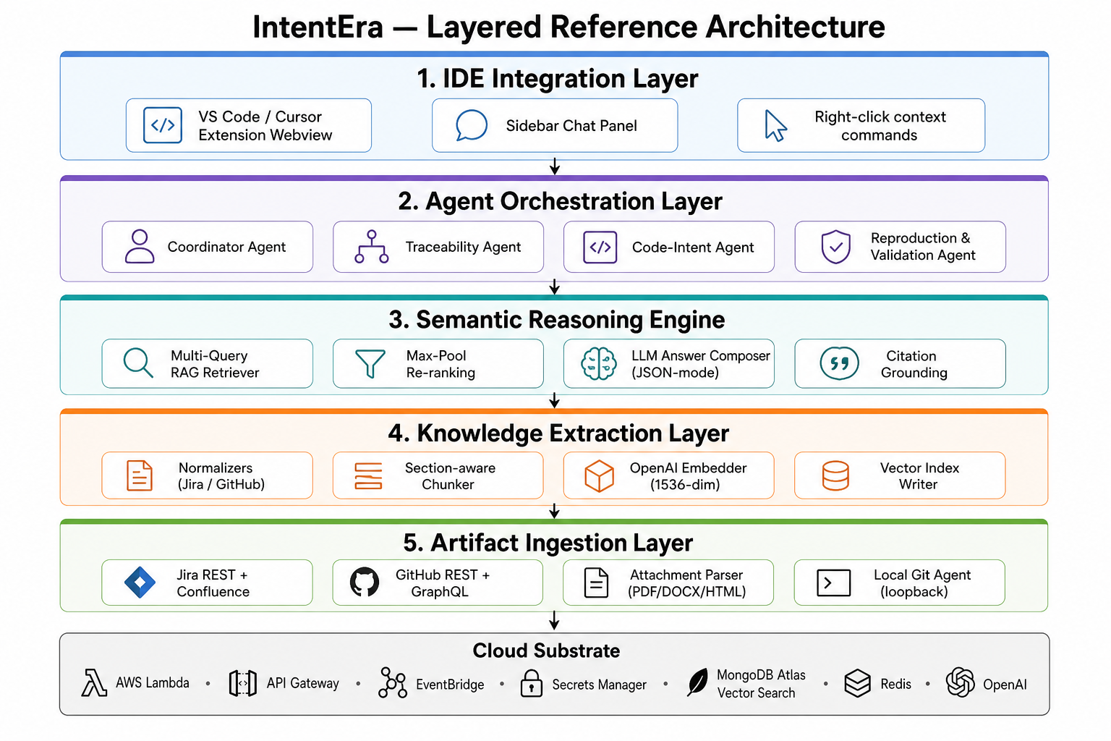
THE WHOLE SYSTEM ON ONE SLIDE
IntentEra at a glance
TECHNOLOGY STACK
AWS Lambda
API Gateway
EventBridge
Secrets Manager
MongoDB Atlas
Vector Search
OpenAI GPT-4o-mini
FIVE LAYERS
text-embedding-3-small
L1
Artifact Ingestion
Upstash Redis
L2
Knowledge Extraction
L3
Semantic Reasoning
VS Code · Cursor
L4
Agent Orchestration
Five-layer reference architecture (Fig. 1, dissertation).
L5
IDE Integration
IntentEra · Final Defence · Architecture · Ch 4
09 / 33

Slide 10
LAYERED SEPARATION OF CONCERNS
The five layers, in one screen
L1 — Artifact Ingestion
Jira REST + Confluence · GitHub REST + GraphQL · Rate-limit aware · Exponential back-off
L2 — Knowledge Extraction
ADF → clean text · PDF / DOCX / HTML parsers · Section-aware chunker · OpenAI embeddings (1536-d)
L3 — Semantic Reasoning
Multi-query retriever · Parallel $vectorSearch fan-out · Max-pool re-ranking · JSON-mode grounded answer
L4 — Agent Orchestration
Coordinator + Code-Intent (live) · Traceability (on demand) · Reproduction + Validation (scaffolded)
L5 — IDE Integration
Single VSIX (VS Code + Cursor) · Sidebar webview · Right-click commands · Loopback Local Git Agent
IntentEra · Final Defence · Architecture · Ch 4.2
10 / 33

Slide 11
ARCHITECTURAL PRINCIPLES
Five principles that shaped every decision
L
S
I
G
$
Layered separation
Source neutrality
Idempotence
Strong grounding
Cloud-native economics
Ingestion, extraction, reasoning, orchestration and IDE are independently testable and replaceable.
Jira, GitHub and future sources share the same embedding + vector-store pipeline. New source = fetcher + normaliser only.
Every chunk has a deterministic id sha256(source|entityKey|chunkSlot) — re-runs are no-ops.
The LLM never speaks without a context package. Citations not present in context are dropped before they reach the developer.
Pay-per-invocation Lambdas + free-tier Redis keep monthly cost in single-digit US-cents for bursty developer workloads.
IntentEra · Final Defence · Architecture · Ch 4.1
11 / 33

Slide 12
SECTION 03 · CHAPTER 6
Chunking, Embeddings, Retrieval.
The reasoning engine, the heart of IntentEra.
IntentEra · Final Defence · Reasoning Engine
12 / 33

Slide 13
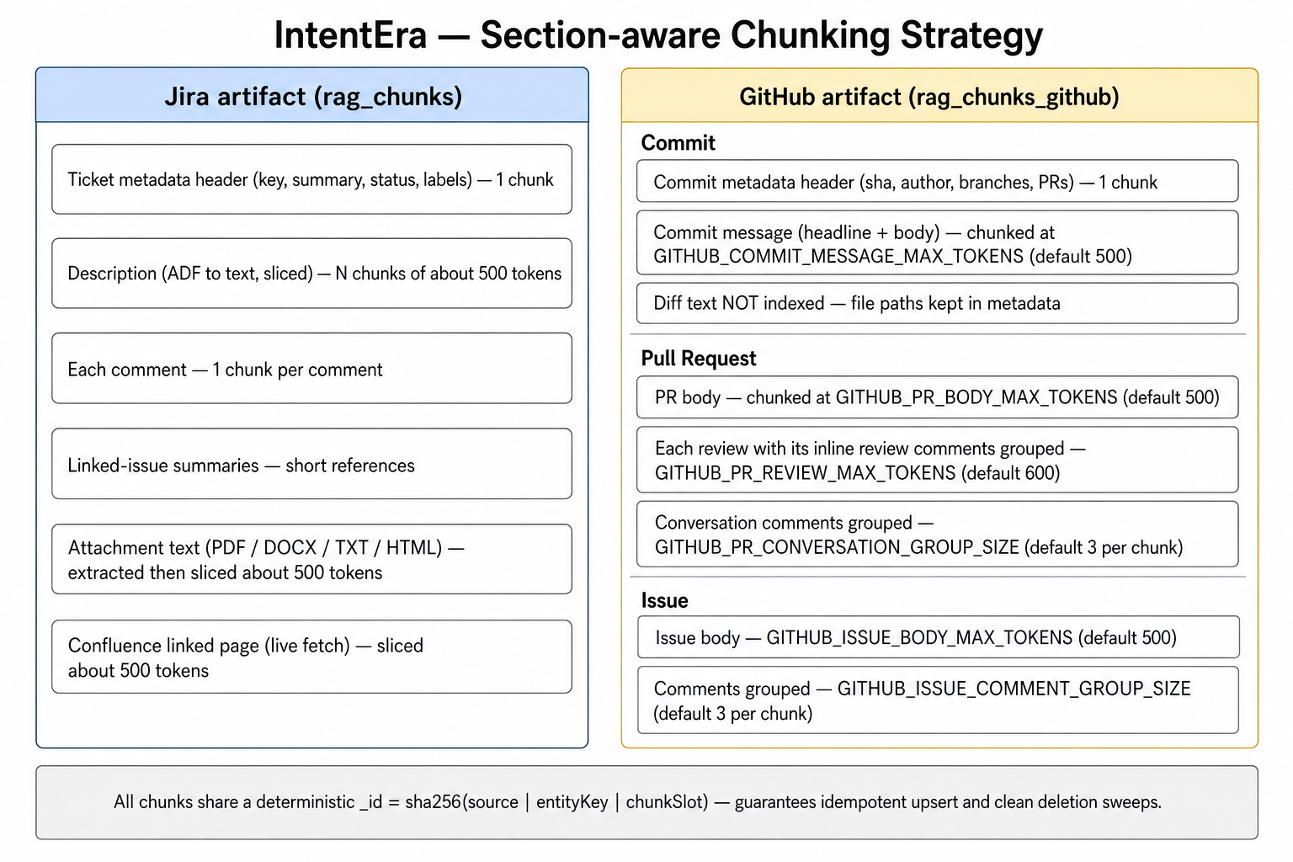
MOST CONSEQUENTIAL PREPROCESSING DECISION
Section-aware chunking — one idea per chunk
WHY NOT UNIFORM-LENGTH?
Naive splits destroy semantic structure — a key claim can land across two chunks, halving the chance retrieval ever finds it.
CHUNK TYPES
Jira
metadata · description · comment · attachment
GitHub commits
commit message · diff summary
Pull requests
PR body · review threads (grouped)
Issues
body · comments
Confluence
page sections · attachments
Token caps configurable via *_MAX_TOKENS
and *_GROUP_SIZE environment variables.
Per-artifact section-aware chunking (Fig. 32, dissertation).
IntentEra · Final Defence · Reasoning · Ch 6.1
13 / 33

Slide 14
WHY INCREMENTAL SYNC IS SAFE AND CHEAP
Idempotent ids + 1536-dim embeddings
DETERMINISTIC CHUNK ID
_id = sha256( source | entityKey | chunkSlot )
Re-ingesting the same artifact produces the same ids — MongoDB upsert is a no-op when nothing has changed, a consistent overwrite when it has.
1,536
1× class
Batched
EMBEDDING DIMENSIONS
PLUGGABLE EMBEDDER
SINGLE ROUND-TRIP
OpenAI text-embedding-3-small — shared across natural language and code-adjacent artifacts.
Swap to a code-specialised model by changing one constructor — no other code touches.
All query embeddings batched in one OpenAI call. Exponential back-off on transient failures.
→ Hourly incremental sync re-embeds only what changed since the previous run — the dominant external cost lever, controlled by design.
IntentEra · Final Defence · Reasoning · Ch 6.2 – 6.3
14 / 33

Slide 15
MONGODB ATLAS VECTOR SEARCH
Two collections, one cluster, hybrid filters
rag_chunks
ATLAS CLUSTER
Source: Jira
M10 · Three-node Replica Set
_id · ticketKey · projectKey · type
(metadata / description / comment / attachment)
chunkIndex · text · embedding[1536]
ap-south-2 (Hyderabad)
Two vector indexes — vector_index and vector_index_github — over the 1536-dim embedding field, plus per-source filter fields for hybrid IR + neural queries.
rag_chunks_github
WHY THE REGION SPLIT
Source: GitHub
AWS workload in ap-south-1 (Mumbai) — proximity to the team.
Atlas in ap-south-2 (Hyderabad) — additional redundancy without trans-oceanic latency on every query.
_id · entityKey (e.g. commit:<sha>) · entityType
repoFullName · branches · prNumber
chunkSlot · text · embedding[1536]
IntentEra · Final Defence · Reasoning · Ch 5.6
15 / 33

Slide 16
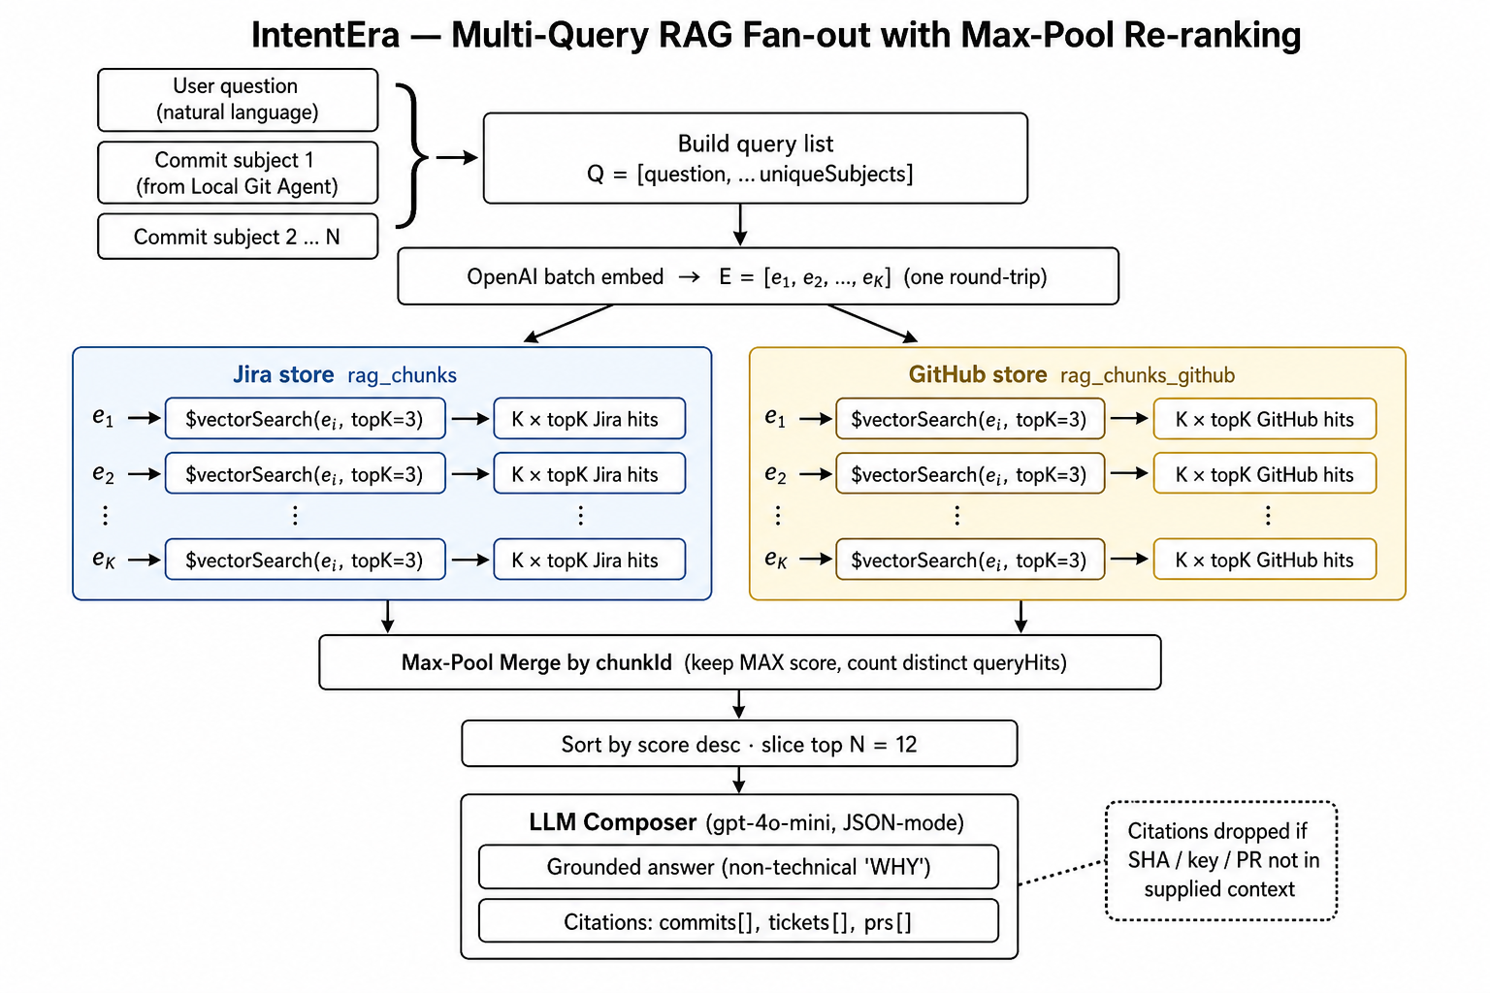
QUESTION + COMMIT SUBJECTS → GROUNDED CONTEXT
Multi-query retriever — the heart of the engine
ALGORITHM — FOUR STEPS
01
Dedupe & batch
Concatenate question + unique local commit subjects → list Q.
02
Embed once
All K queries embedded in a single OpenAI call.
03
Parallel $vectorSearch
Each embedding → both Atlas collections, top-K = 3.
04
Max-pool merge
Group by chunkId, keep max score, sort, slice to top N (= 12).
Multi-query RAG fan-out (Fig. 33, dissertation).
IntentEra · Final Defence · Reasoning · Ch 6.4
16 / 33

Slide 17
RE-RANKING DESIGN CHOICE
Why max-pool — and why not the obvious alternatives
Average score across queries
✗ Rejected
Dilutes a chunk that is decisively relevant to one query but only weakly relevant to another — exactly the signal we want to preserve.
Concatenate queries into one string
✗ Rejected
Conflates orthogonal signals into a single embedding, degrading retrieval quality for every individual query.
Max-pool by chunkId ← the choice
✓ Adopted
Keep the maximum score across queries for each chunk. A ticket whose title closely matches one commit subject is promoted into the top of the merged list, even when its match against the user's question is moderate.
→ Max-pool is essentially a soft ensemble — it lets the strongest evidence per chunk speak, regardless of which query found it.
IntentEra · Final Defence · Reasoning · Ch 6.4 (rationale)
17 / 33

Slide 18
LLM ANSWER COMPOSITION
Three-layer defence against hallucination
01
JSON-Mode Prompt
02
Post-Filter Citations
03
Clickable in the IDE
LLM (OpenAI gpt-4o-mini) is forced into JSON-mode and instructed to emit a non-technical "why" paragraph plus three citation lists — commits, tickets, PRs.
Any commit SHA, ticket key or PR number that does NOT appear in the supplied context is silently dropped before the response leaves the Lambda.
Citations render as clickable references inside the chat panel — the developer can verify each source in one click.
RESPONSE SHAPE (TRUNCATED) — APPENDIX B.5
{
"answer": "In plain English: the retry was added because the SSO ...",
"citations": {
"commits": [ { "sha": "abc1234567...", "subject": "fix(auth): ..." } ],
"tickets": [ { "key": "PROJ-123", "summary": "Intermittent SSO ..." } ],
"prs": [ { "repo": "acme/platform", "number": 451 } ]
},
"retrieved": { "jiraCount": 5, "githubCount": 4, "mergedCount": 9 }
}
IntentEra · Final Defence · Reasoning · Ch 6.5 + 9.5
18 / 33

Slide 19
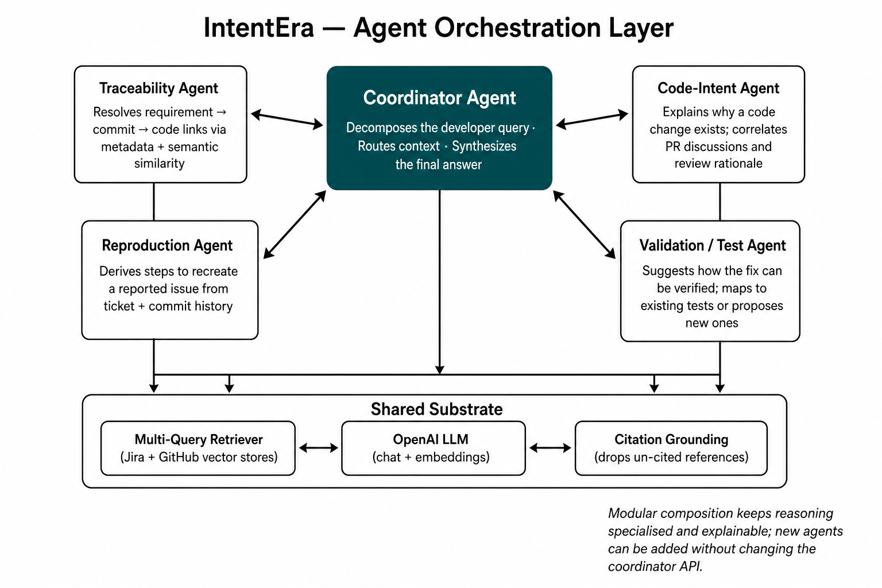
MULTI-AGENT ORCHESTRATION
Specialised agents under one coordinator
AGENT ROSTER
LIVE IN PRODUCTION
Coordinator
Routes context · synthesises responses
Code-Intent
Composes the "why" explanation
ON DEMAND
Traceability
Resolves "which requirement does this implement?"
SCAFFOLDED — FUTURE WORK
Reproduction
Derives repro steps from tickets + commits
Validation / Test
Coordinator routes context to specialised agents (Fig. 34).
Suggests how to verify the fix
IntentEra · Final Defence · Reasoning · Ch 6.6
19 / 33

Slide 20
SECTION 04 · CHAPTERS 5 & 7
IDE Integration & Cloud.
Where the developer experiences IntentEra — and how AWS makes it cheap.
IntentEra · Final Defence · IDE & Cloud
20 / 33

Slide 21
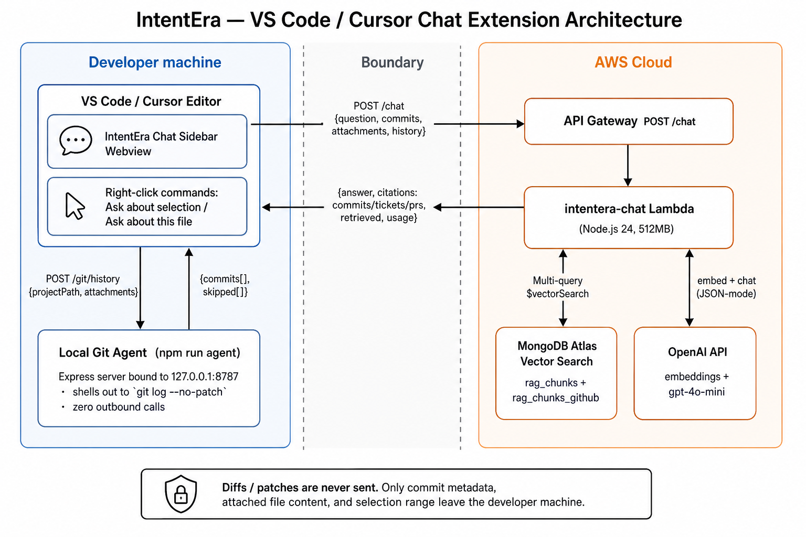
VS CODE & CURSOR EXTENSION
Three pieces — and a deliberate trust boundary
01 · VSIX Extension
Single artifact installs into both VS Code and Cursor (same Code-OSS extension API). Sidebar webview + right-click commands.
02 · Local Git Agent
Tiny Express server on 127.0.0.1:8787 — loopback only. Uses git log --no-patch → metadata only, never diffs. Allowlistable project roots.
03 · Cloud Chat Lambda
Called via API Gateway. Runs the multi-query RAG pipeline + JSON-mode answer composition + citation post-filtering.
Three-piece chat extension architecture (Fig. 35).
IntentEra · Final Defence · IDE · Ch 7.1 – 7.2
21 / 33

Slide 22
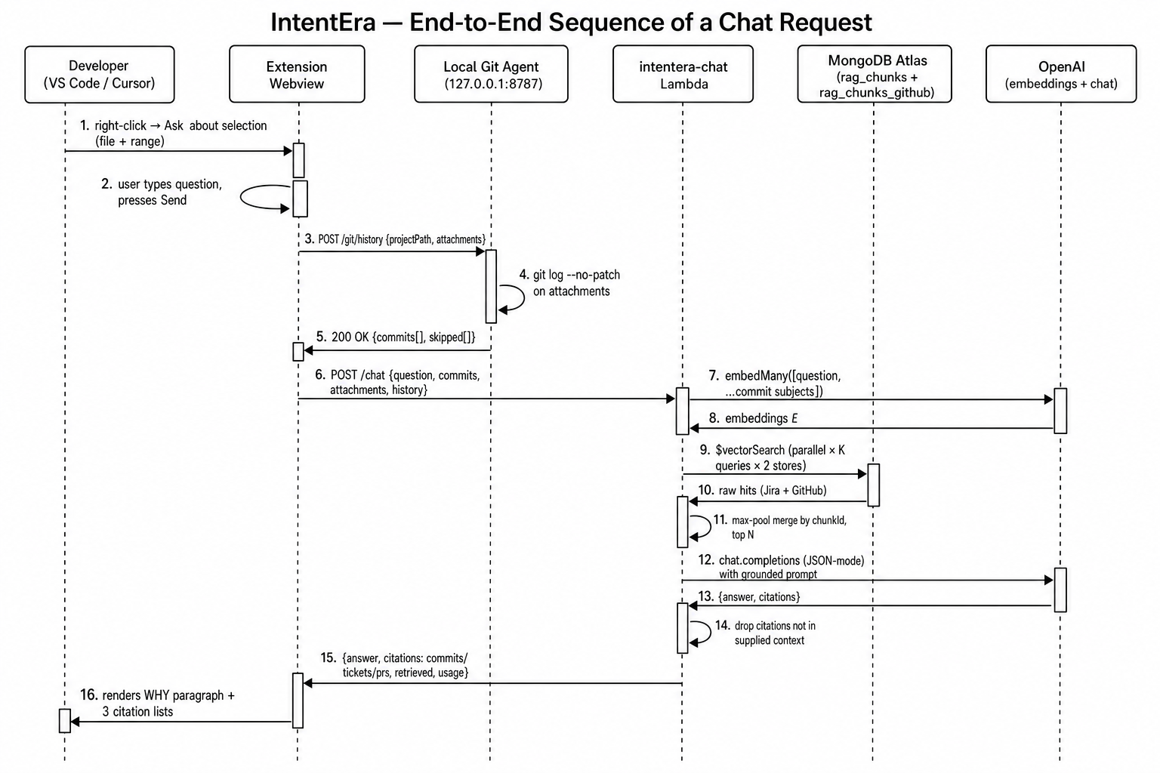
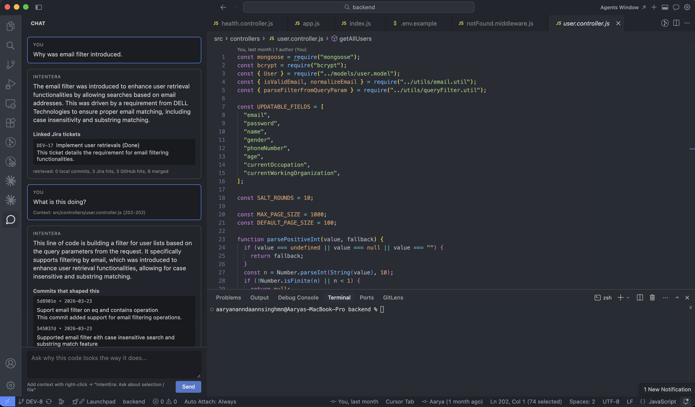
END-TO-END CHAT REQUEST
From right-click to grounded answer
UML-style sequence (Fig. 36).
Cursor chat panel: "Why was the email filter introduced?"
IntentEra · Final Defence · IDE · Ch 7.3 – 7.4
22 / 33

Slide 23
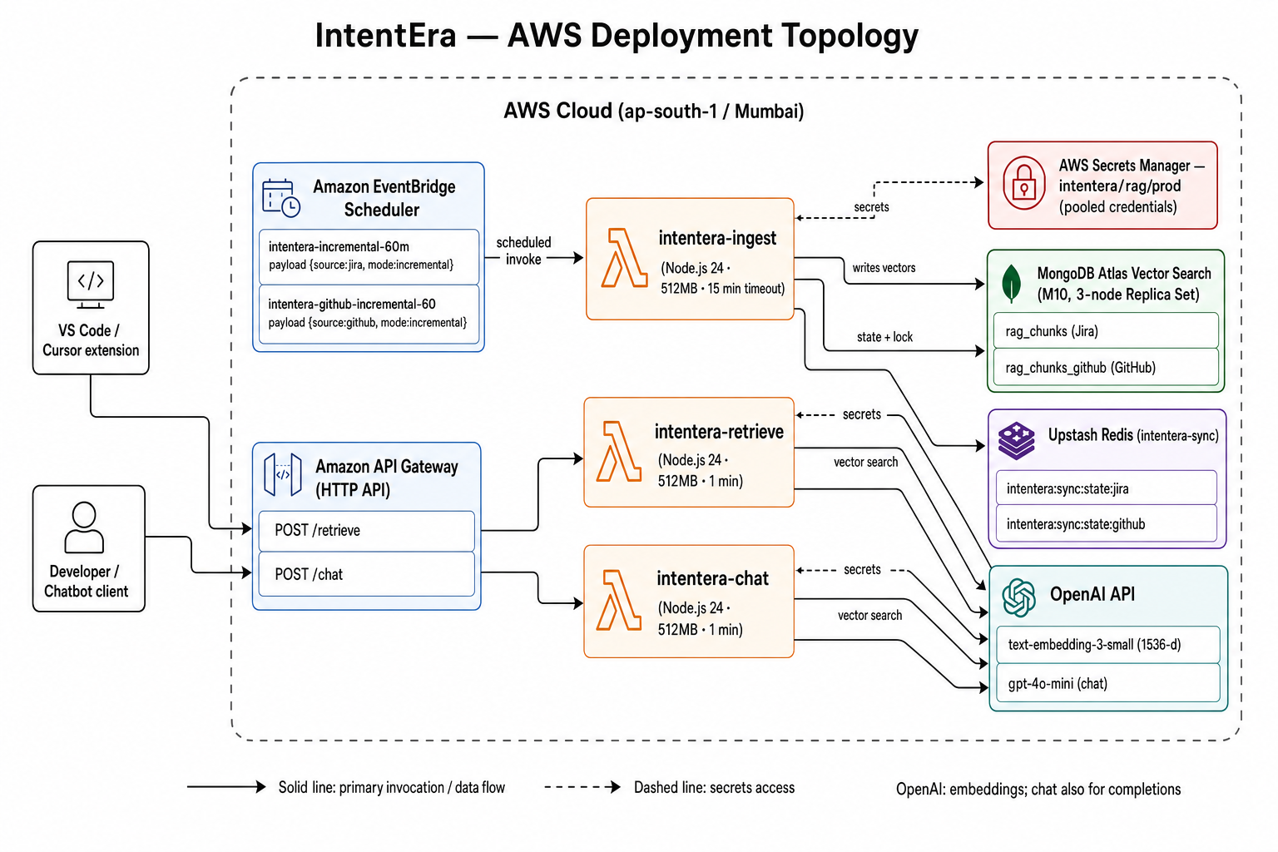
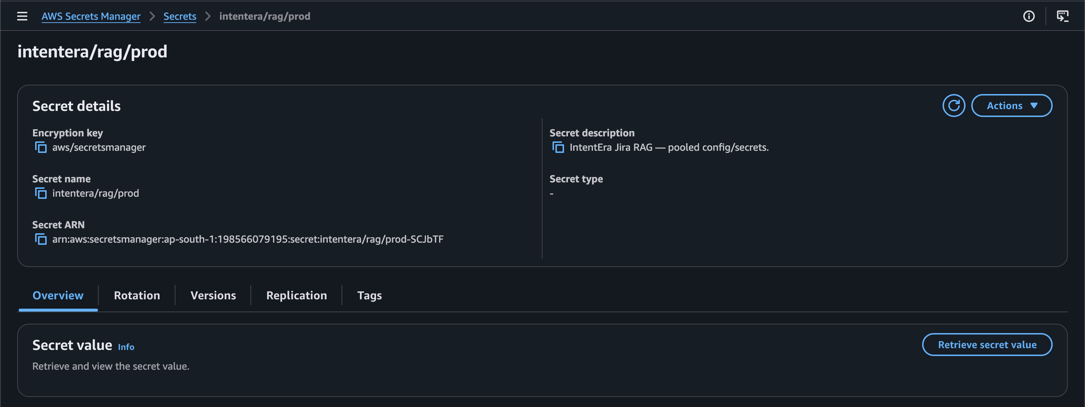
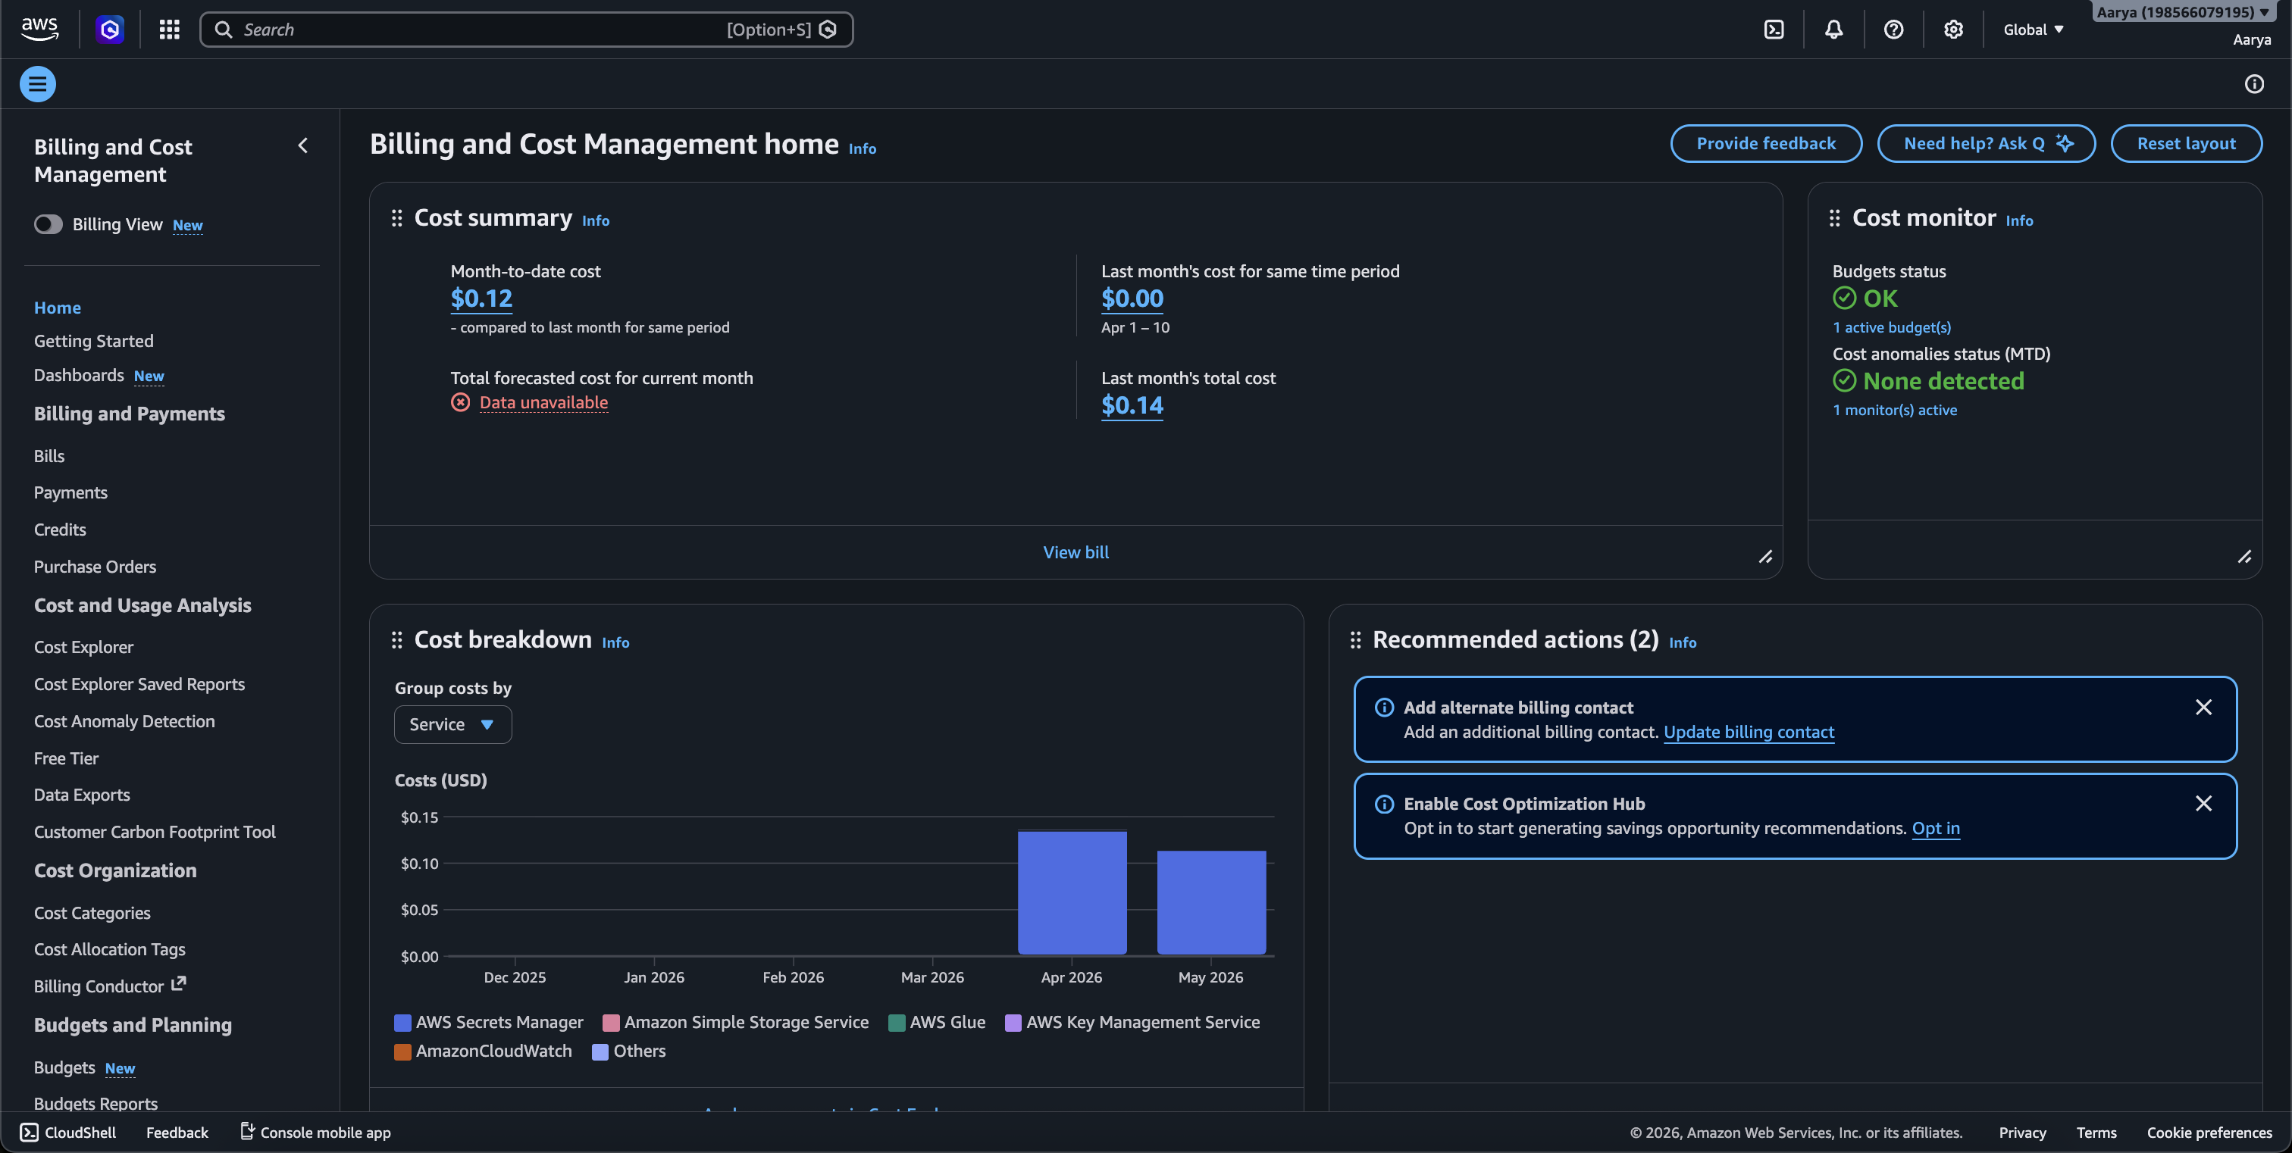
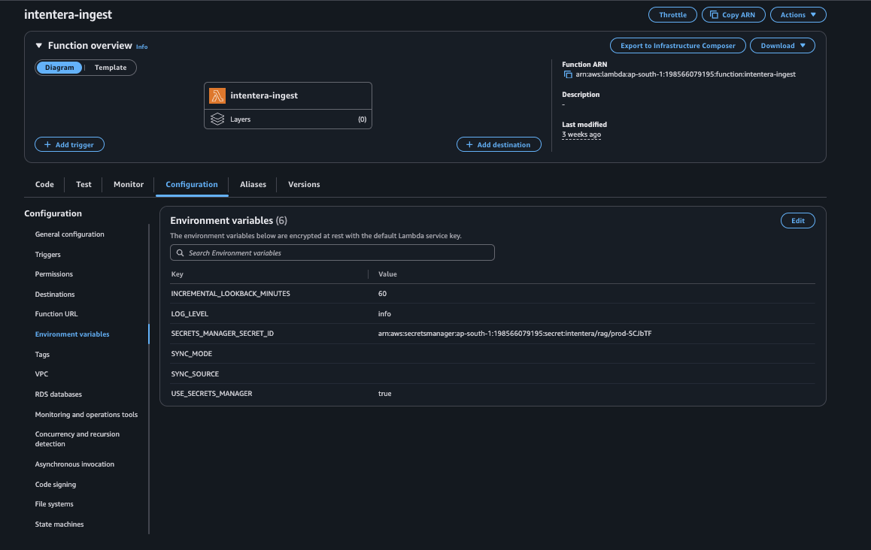
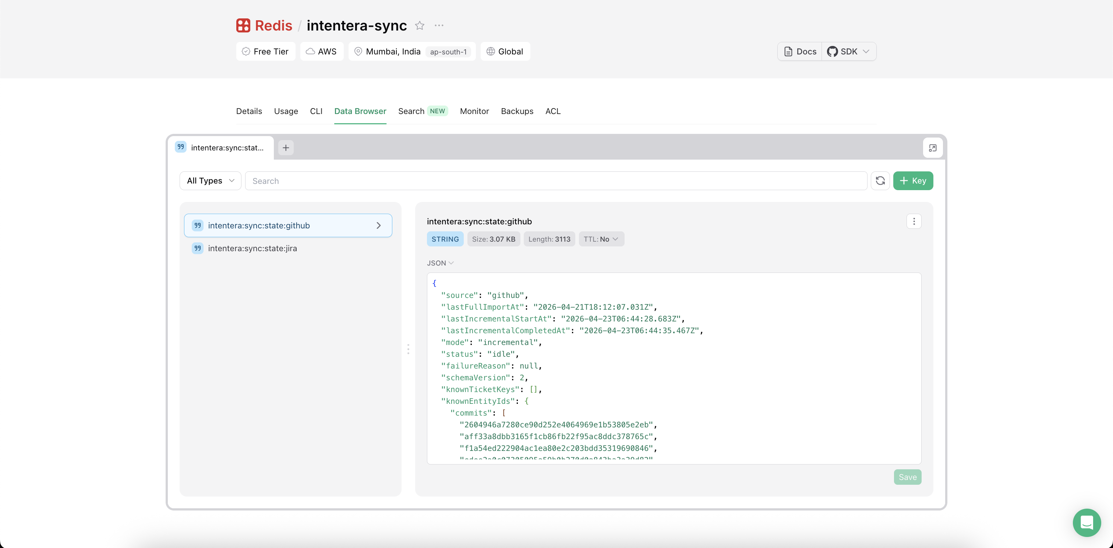
CLOUD-HOSTED, PAY-PER-INVOCATION
Production deployment on AWS
Three Lambdas
EventBridge schedules
Secrets Manager
CloudWatch log groups
EventBridge → Ingest Lambda; API Gateway → Retrieve & Chat (Fig. 2).
IntentEra · Final Defence · Cloud · Ch 5
23 / 33

Slide 24
SECTION 05 · CHAPTER 8
Evaluation & Metrics.
Functional, retrieval, latency, cost — and what three engineers actually felt.
IntentEra · Final Defence · Evaluation
24 / 33

Slide 25
END-TO-END VERIFICATION ON REAL PRODUCTION DATA
10 of 10 functional checks pass
✓
#01
✓
#06
Lambda cold-start under 5 s
P
POST /retrieve returns ranked hits + metadata
P
✓
#02
✓
#07
Full Jira import populates rag_chunks
P
POST /chat returns grounded answer with citations
P
✓
#03
✓
#08
Full GitHub import populates rag_chunks_github
P
Citations not in context are dropped
P
✓
#04
✓
#09
Incremental sync respects 60-min schedule
P
Local git agent rejects non-loopback callers
P
✓
#05
✓
#10
Re-running incremental is idempotent
P
Extension banner reflects agent + Lambda health
P*
P* — minor observation: extension banner wording was reworded twice during testing for non-author readability.
IntentEra · Final Defence · Evaluation · Ch 8.1
25 / 33

Slide 26
QUALITATIVE STUDY ON REAL SLACK-SOURCED QUESTIONS
Retrieval quality and cognitive-load impact
15 / 15
≤ 3
3 / 3
QUESTIONS WITH ≥1 GOLD ARTIFACT IN TOP-12
POSITION OF THE FIRST GOLD ARTIFACT (MEDIAN)
ENGINEERS SHOWED REDUCED CONTEXT-SWITCHES
Curated from real Slack threads in the employing organisation, supervisor-graded.
In the majority of cases the first gold artifact appeared in the top three merged hits.
30-min sessions on unfamiliar repos with vs. without the extension. Self-reported confidence rose because citations are checkable.
MAX-POOL RE-RANKING IN THE WILD
Max-pool behaved as designed.
Artifacts that scored only moderately on the user's question but very strongly on a specific commit subject — for example a Jira ticket whose title closely matched a commit subject — were reliably promoted into the top of the merged list.
A formal precision-recall evaluation against a larger dataset and a NASA-TLX cognitive-load study are identified as future work.
IntentEra · Final Defence · Evaluation · Ch 8.2 + 8.4
26 / 33

Slide 27
CLOSING THE EXPLAINABILITY LOOP
From grounded citations to per-claim accountability
hits / K
cos-Δ
−1 cite
PER-CITATION CONFIDENCE
POST-HOC FAITHFULNESS PROBE
COUNTERFACTUAL CITATION TEST
Surface the per-query hit count the max-pool retriever already computes — render it next to every citation chip in the IDE chat panel.
cos(answer, retrieved-context) vs. cos(answer, random-chunk). Flag answers below the gap threshold for human review before they ship.
Re-run the chat with the top-1 cited artifact removed. If the answer is unchanged, mark that citation non-load-bearing in the UI.
WHAT INTENTERA EXPLAINS — AND WHAT IT DOESN'T
Retrieval-level explainability today; mechanistic attribution as future work.
IntentEra explains which artifacts grounded an answer — citations, per-citation confidence, and counterfactual sensitivity — making every claim auditable in one click. It does not (yet) explain the LLM's internal reasoning: token-level attribution and mechanistic interpretability remain out of scope for this dissertation and are listed in future work as direction 02.
IntentEra · Final Defence · Evaluation · Explainability
27 / 33

Slide 28
OPERATIONAL ECONOMICS
Latency and cost — viable for a small team
< 5 s
single-digit ¢
TYPICAL END-TO-END CHAT REQUEST
AWS SPEND PER MONTH
Measured across 50 real interactions — right-click to rendered answer. Well under the 60 s Lambda timeout. LLM call dominates.
Lambdas + Secrets Manager + EventBridge. Atlas M10 is the lower bound of the dedicated tier.
K × 2
2 × OpenAI
ATLAS $VECTORSEARCH OPS PER CHAT
EXTERNAL LLM CALLS PER CHAT
K = #queries (1 + per local commit subject); × #stores (Jira + GitHub). Negligible per query, parallelised across stores.
One batched embedding round-trip + one chat completion. Embeddings are amortised across all queries in the request.
Incremental sync re-embeds only what changed → OpenAI cost scales with delta, not corpus size.
IntentEra · Final Defence · Evaluation · Ch 5.10 + 8.3
28 / 33

Slide 29
SECTION 06 · CHAPTERS 9 & 10
What's Next.
Honest limitations, what we shipped, and where the framework goes from here.
IntentEra · Final Defence · What's Next
29 / 33

Slide 30
WHERE THE SYSTEM STRUGGLES, AND HOW WE MITIGATE
Challenges and limitations — documented honestly
NL → code gap
Noisy artifacts
Missing traceability
Source heterogeneity
Requirements are informal, code is structured. Multi-query retriever helps; abstract requirements remain edge cases.
"minor fix" commits, empty PRs. Mitigated by preserving metadata + ingesting reviewer comments as their own chunks.
Many commits don't reference a ticket. Combination of metadata + semantic similarity, with hit counts exposed.
Each platform has its own format and rate-limits. Per-source normalisers and Redis state keep the reasoning core clean.
LLM hallucination
Cold start
Scale & scope
Three-layer defence: JSON-mode + post-filter + clickable citations. Cannot guarantee zero, substantially reduced.
Mongo / Redis / OpenAI clients are cached across warm invocations. Provisioned concurrency is available if needed.
2 source families today, managed-cloud only, no benchmarks at 100k+ artifacts yet. Designed for incremental growth.
IntentEra · Final Defence · Limitations · Ch 9
30 / 33

Slide 31
CURRENT IMPROVEMENTS
What's improved since the midterm — already in production
✓
✓
✓
✓
✓
Section-aware chunker
JSON-mode + post-filter grounding
Max-pool re-ranking
Loopback Local Git Agent
Single VSIX, two IDEs
Replaces uniform-length splits with one-idea-per-chunk windows. Removed cross-boundary loss of key claims.
LLM forced into JSON-mode; uncited identifiers stripped before reaching the developer. Eliminates fabricated SHAs.
Single-batch query embedding + parallel $vectorSearch + max-pool merge replaces single-query nearest-neighbour search.
Replaces sending diffs/patches to the cloud. Only metadata leaves the machine; agent binds to 127.0.0.1.
One artifact installs into both VS Code and Cursor. Same right-click commands, same sidebar everywhere.
IntentEra · Final Defence · Improvements · already shipped
31 / 33

Slide 32
FUTURE WORK
Five directions worth pursuing next
01
Code Evolution Graph
Index the repository's call graph as a first-class artifact — answer questions that depend on cross-file structure, not only textual similarity.
02
Mechanistic / Token-Level Attribution
Move beyond retrieval-level explainability — surface which input tokens supported each clause of the generated answer, using attention-rollout or gradient-based attribution methods.
03
Regression-Test Suggestion Agent
Extension of the Validation/Test agent — propose specific tests to add after a fix, grounded in the same artifacts the chat answer cites.
04
Cross-Repository Dependency Tracing
Ingest multiple repositories and express their dependencies in the vector index — addresses platform-and-service split monorepos.
05
Knowledge-Graph Semantic Memory
Layer an explicit knowledge graph on top of the vector store — enables path-based and temporal questions that vector similarity alone cannot support.
IntentEra · Final Defence · Future Work · Ch 10.4
32 / 33

Slide 33
CHAPTER 10 · CLOSING REMARK
Implementation rationale,
often assumed to be irretrievably lost
as software evolves,
can in fact be computationally reconstructed.
IntentEra demonstrates that intent-aware development environments are not only feasible but practical — and that traceability can be an active form of cognitive augmentation, not a documentation aspiration.
THANK YOU
AARYA NANNDAANN SINGH M N
Questions & Discussion
BITS ID · 2024MT03013
M.Tech Cloud Computing
WILP Dissertation CCZG628T · May 2026
With thanks to my supervisor, examiner and faculty mentor.
IntentEra · Final Defence · Conclusion
33 / 33

